Slide 1




Non-Verbal Communication
And Barriers Within It

Slide 2
Group Members
Danial Ahmad
Tariq Umar
Saad Bakhtiar
CMS: 331388
CMS: 334943
CMS: 341150
Muhammad Ahmed
Mohsin
Muhammad
Umer
CMS: 333060
CMS: 345834

Slide 3
Table of Content
1
Introduction to Non Verbal Communication
2
Types and Importance
3
Barriers Faced
4
Barriers Faced
5
Conclusion and Solution

Slide 4


Non Verbal Communication
What is Non-Verbal communication?
Is it really effective?
A report published by IJRAR (International Journal of Research and Analytical Reviews), shows 55% of the meaning of the message is through the face and body.

Slide 5
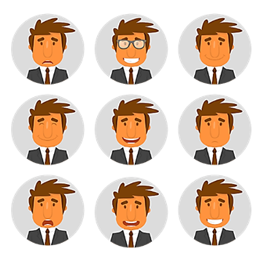
Non Verbal Communication
Expressions and Body language are much harder to “fake”
A person may involuntarily make a face or gesture, due to his lack of control over his emotions
Facing barriers and problems

Slide 6
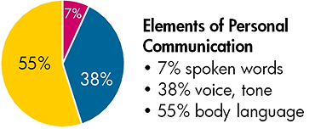
Importance
Can repeat, accent and complement a verbal message
Creates an image in the listener’s mind
Makes a conversation becomes engaging and interactive
Changes meaning of words
Contradiction, non-verbal prevails
“The most important thing in communication is to hear what isn’t being said.”
Peter F. Drucker, a well-known management consultant

Slide 7
Types
1
2
3
Appearance
Body Language
Expressions
4
5
6
Proxemics
Oculesics
Haptics
7
8
9
Gestures
Vocalics
Chronemics

Slide 8
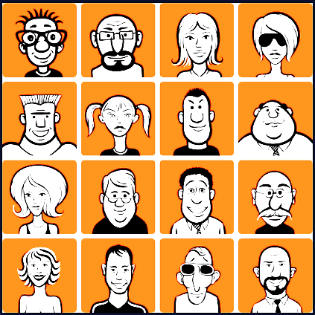
Appearance
First non-verbal message on which a perception is made.
Incudes one’s gender, dress, hair style, accessories, and the overall attractiveness.
Do not give too much importance
“Don’t judge a book by its cover.”

Slide 9
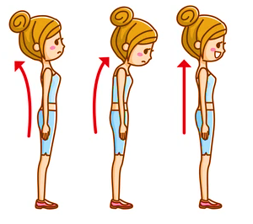
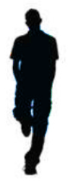
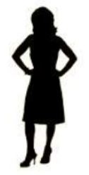
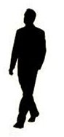
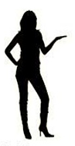
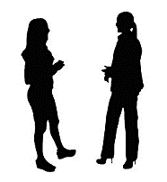
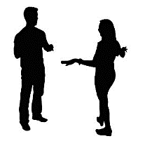
Body Language
Posture and Movement indicates your Confidence and Personality
Close Posture – Nervousness/ Closed Personality
Open Posture – Confidence
Good speaker fluctuates between them
Movement adds energy and variety
Standing Frozen on one point indicates nervousness
Sway
Back
ForwardHead
Upright
Postures

Slide 10

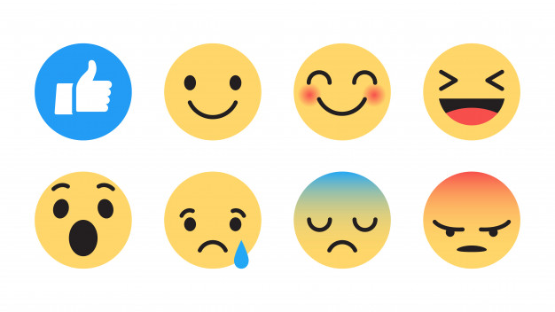

Facial Communication
Definition
Facial communication means to study the movement of muscles of the face and infer somebody’s emotional state.
Universality of Facial Gestures
How can they cause miscommunication?

Slide 11
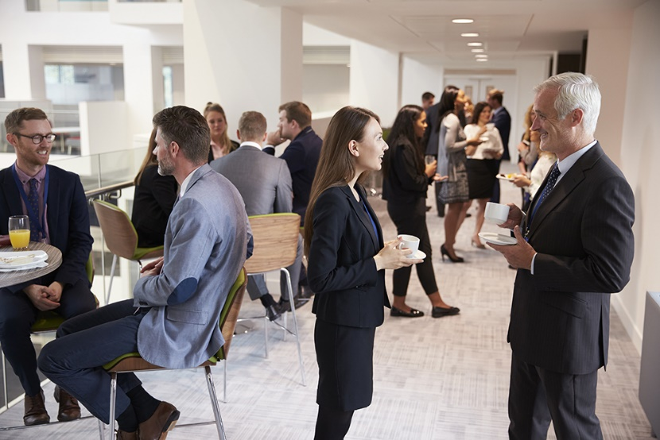
Proxemics
Definition
The study of spatial communication and how we use it in our day-to-day conversations.
What is personal space?
Types of Territories
How It May Cause Miscommunication

Slide 12
Theories
Equilibrium Model
Equilibrium theory holds that intimacy and distance vary together. The greater the intimacy, the closer the distance; the lower the intimacy, the greater the distance
Protection Theory
People establish a protective zone around their body in order to avoid harmful or unwanted attacks. This theory has seen application in times of COVID-19 pandemic
Expectancy Violation Theory
Expectancy violations theory (EVT) is a theory of communication that analyzes how individuals respond to unanticipated violations of social norms and expectations

Slide 13
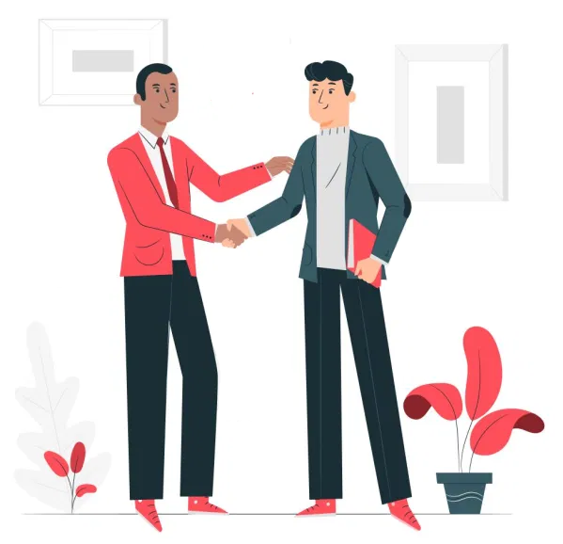
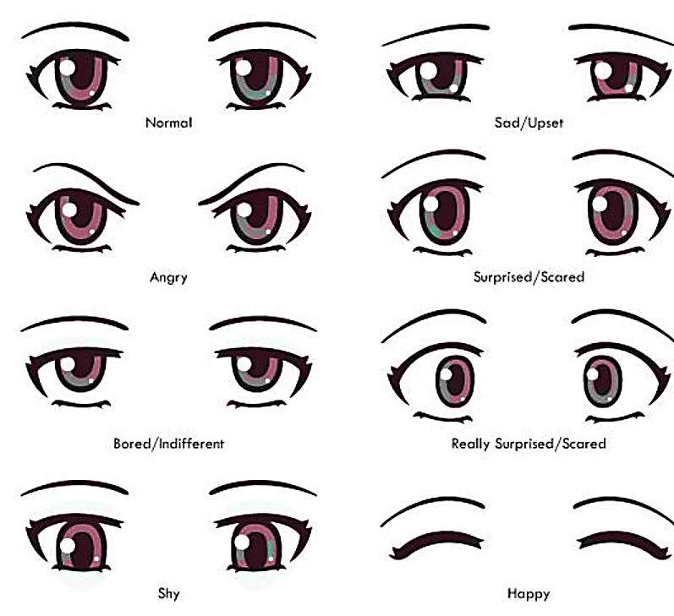
Oculesics
Haptics
Definition
It is the form of communication in which we infer messages from the eye.
Characteristics
Examples
Miscommunication
Definition
The communication through the sense of touch. It is the most effective way of communicating feelings.
Types of Touch
Miscommunication

Slide 14


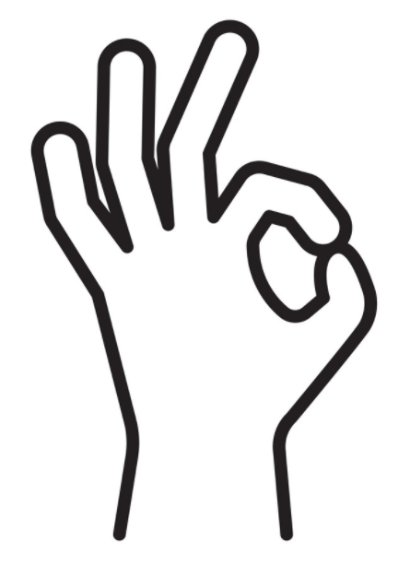
Gestures
Definition
A gesture is a specific bodily movement that reinforces a verbal message or conveys a particular thought or emotion.
Subdivisions
Emblems
Illustrators
Adaptors
Examples
Miscommunication

Slide 15
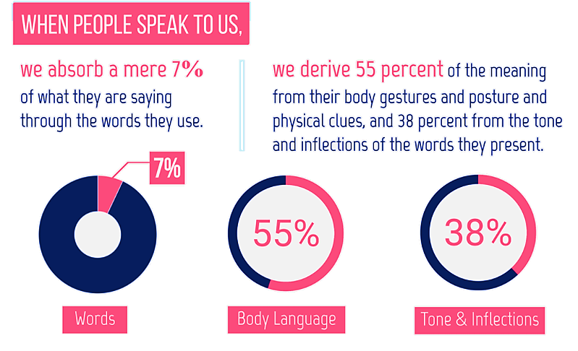
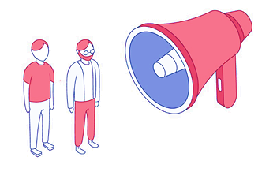
Vocalics
Definition
It is the study of paralanguage, which includes the vocal qualities that go along with verbal messages, such as pitch, volume, rate, vocal quality, and verbal fillers
We are utilizing vocalics when we sigh, gasp, laugh or cry, and even change the intensity and manner of our tone.

Slide 16

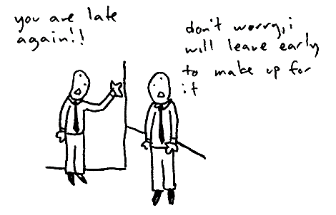
Chronemics
Definition
It is the study of the use of time in nonverbal communication. The way we perceive time, structure our time and react to time is a powerful communication tool, and helps set the stage for communication.
Perceptions of time include punctuality and willingness to wait, the speed of speech and how long people are willing to listen.
Examples
Miscommunication

Slide 17

Solutions
Paying More Attention
Solution
Solution
Better Eye Contact
01
02
Ask Questions
Solution
Focusing on Tone
Solution
06
03
Solution
Solution
Focusing on Behavior
Inferring Signals
05
04

Slide 18
Paying Attention
People can communicate information in numerous ways
Pay attention to things like eye contact, gestures, posture, body movements, and tone of voice
All of these signals can convey important information that is not put into words
By paying closer attention to other people's unspoken behaviors, you will improve your own ability to communicate nonverbally

Slide 19
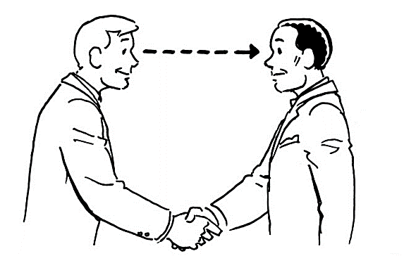
Eye Contact
When people fail to look others in the eye, it can seem as if they are evading or trying to hide something.
On the other hand, too much eye contact can seem confrontational or intimidating.
Effective eye contact should feel natural and comfortable for both you and the person with whom you are speaking

Slide 20
Tone of Voice
Your tone of voice can convey a wealth of information, ranging from enthusiasm to disinterest to anger
Tone can be an effective way to amplify your message
Incongruent Behavior
Someone might tell you they are happy while frowning and staring at the ground
If someone's words do not match their nonverbal behaviors, you should pay careful attention
So when someone says one thing but their body language suggests something else, it can be useful to pay extra attention to those subtle nonverbal cues

Slide 21
Signals
A single gesture can mean any number of things, or maybe even nothing at all
The key to accurately reading nonverbal behavior is to look for groups of signals that reinforce a common point
Questions
If you are confused about another person's nonverbal signals, don’t be afraid to ask questions.
Sometimes simply asking such questions can lend a great deal of clarity to a situation.
For Example
"So what you are saying is that..."
"Do you mean that we should..."
"What I'm hearing is that you think..."

Slide 22
Thank You
Any Questions?

